Slide 1

Optimizing an NBA Roster
An ISE 3230 Project
By Ryan Marshall, Nate Rezell,
and Austin Trout
December 1, 2021 - 12:45pm

Slide 2


Introduction
Goal: Build a championship level NBA roster of current players
Process: Use 538's RAPTOR metric to estimate player impact, then maximize total team impact subject to real world team building constraints.

Slide 3

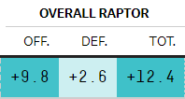
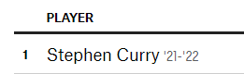
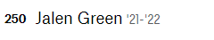
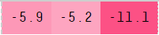
“RAPTOR” Score
Measure of player effectiveness created by FiveThirtyEight
Plus-minus statistic attributed to each player
Measures a player's contributions to his team per 100 possessions
...
...

Slide 4
Variables and Objective
Decision Variable:
S_{n} = Player n is either selected(1) or not(0) for the starting lineup
B_{n} = Player n is either selected(1) or not(0) for the bench
n = {1,…, 362}
Objective function:
maximize z = 36 * ΣR_{n}S_{n} + 8.5 * ΣR_{n}B_{n}
Where z is the effectiveness of the roster, weighted by playing time, and measured by total RAPTOR score

Slide 5

Constraints
Roster Size
5 Players chosen for the starting lineup
2 guards, 2 forwards, 1 centers
7 Players chosen for the bench
At least 2 guards and 2 forwards, exactly 2 centers
Salary Cap
Total Salary must adhere to NBA cap
($109,000,000)
Effective on Both Sides
Bench avg Off/Def RAPTOR Score non-negative

Slide 6
Optimal Solution
STARTING LINEUP
Pos | Name | Total RAPTOR
G | Derrick White | 4.620
G | Cameron Payne | 4.153
F | Kawhi Leonard | 6.588
F | Giannis Antetokounmpo | 7.812
C | Nikola Jokic | 9.249
 | TOTAL: | 32.422
BENCH
Pos | Name | Total RAPTOR
G | Devonte Graham | 2.397
G | Furkan Korkmaz | 2.170
G/F | Luguentz Dort | 2.067
F | David Nwaba | 3.181
F | John Konchar | 2.326
C | Daniel Gafford | 3.852
C | Nicolas Claxton | 5.029
 | TOTAL: | 21.022

Slide 7
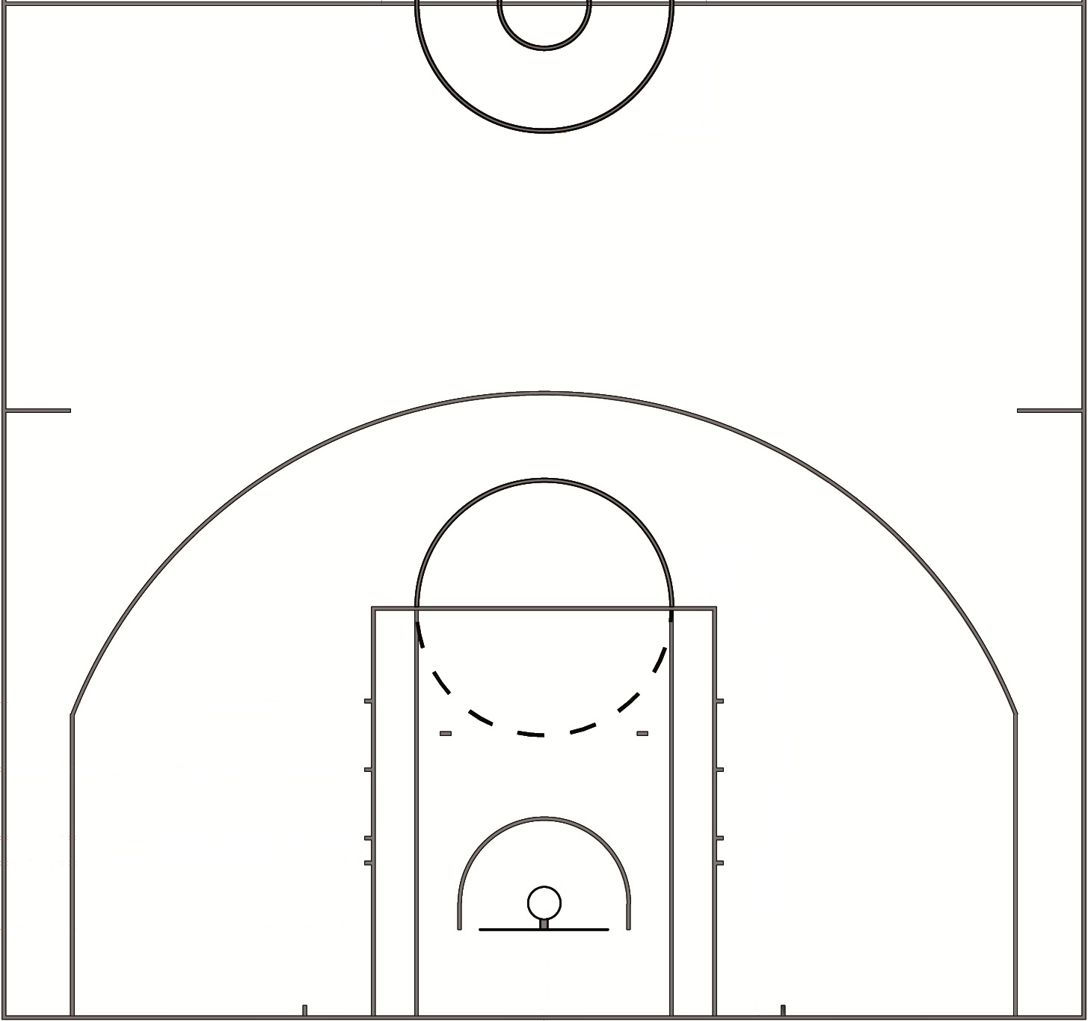

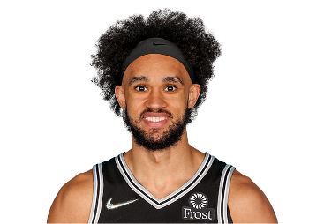

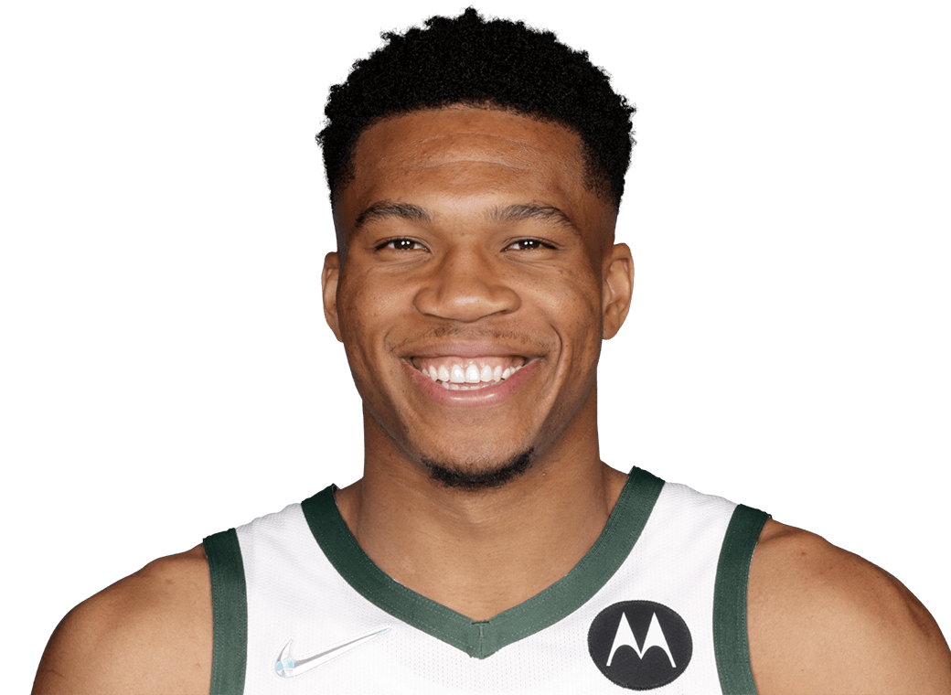
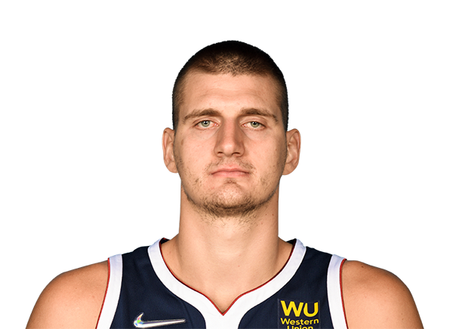
Cameron Payne (PG)
Derrick White (SG)
Kawhi Leonard (SF)
Giannis (PF)
Nikola Jokic (C)

Slide 8


Team Projection
-Using 538's "Roster Shuffling Machine"
-Place our selected players onto one team
-RAPTOR scores are used to project team success
OHIO STATE BUCKEYES

